Slide 1

Morden Supermarket Security System Design
Kailai Lin, Zhenyu Zhu, Ruowei Xing, Huanxi Tong
Notes:
Hello everyone, welcome to today's video where we'll be diving into the design of a modern supermarket security system and how we address potential threats.

Slide 2

Assets Identification
Customer Data: Including customer profile information, e.g. preferred names, addresses, contact details, and potentially sensitive data like purchase information (commonly used card type and partial card number), purchase history, and preferences.
Access Interface: The designed function for accessing and managing available resources, inclusive but not limited to database, functional machine learning (ML) models, etc.
Database: Where collected data and trained model would be stored or backed up.
Notes:
In the past decade, the digital landscape has rapidly evolved, transforming various industries, including retail. Digital applications have enhanced both online and in-store shopping experiences. Our supermarket scenario involves critical assets like customer data, access interfaces, and databases. Customer data encompasses profile information and purchase details, while access interfaces facilitate resource management, and databases store collected data and trained models.

Slide 3
Threat Identification
Victim: Any entities involved in utilising or managing the system would become a victim in the worst case, including the customers, store and its employees, and external service provider, as they could be subject to reputation damage if found responsible.
Adversary: Any entities that could make unethical interest by accessing the data and functional blocks, malicious attackers, etc.
Threats: Malicious Attacks and software leakage, unexpected personal identification information (PII) exposure, internal system & third-party application vulnerabilities, etc.
Notes:
We've identified:
Victims: Customers, store employees, and service providers are vulnerable to reputational damage.
Adversaries: Malicious attackers seek to exploit vulnerabilities for personal gain.
Threats: These include malicious attacks, software leakage, and PII exposure.

Slide 4
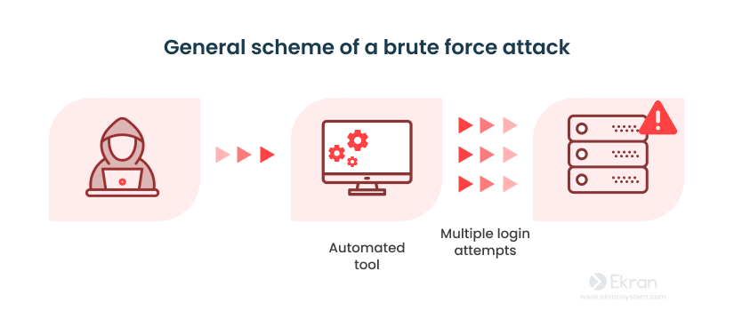
Attack implementation: Brute force attack
Five strategies are available:
"common_pass" leverages frequently used passwords.
"common_name" targets popular first names.
"digit" tests numeric passwords.
"digitAndLowercase" broadens to include letters and numbers.
"fullCase" explores complex passwords with ASCII characters.

Slide 5
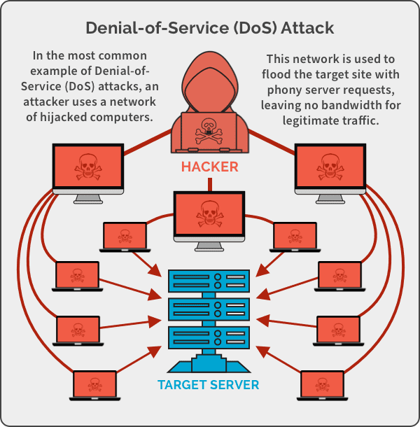
Attack implementation: Dos Attack
Target supermarket website is identified by the IP address " 127.0.0.1 “ and port '8000’
Attack generate by the address ‘182.21.20.32'

Slide 6
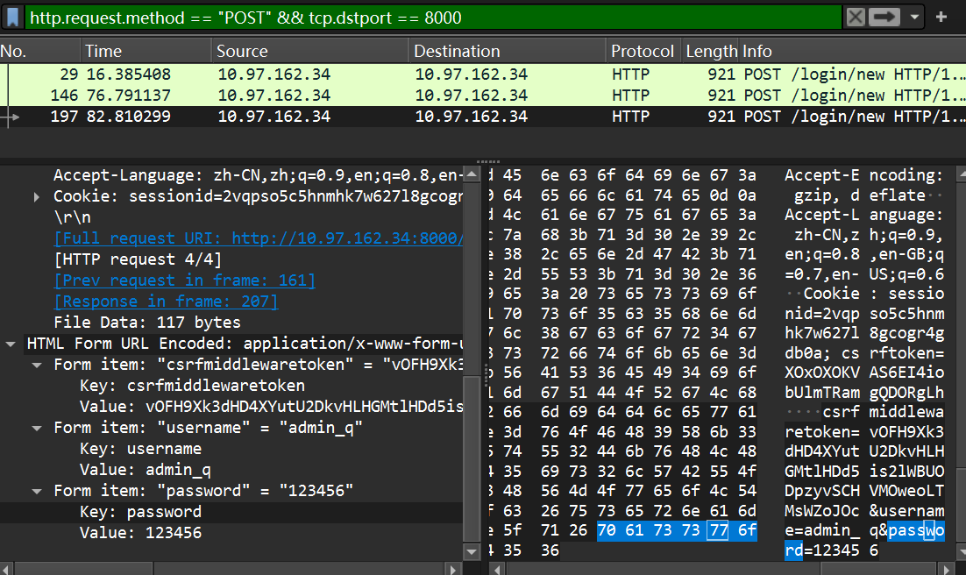
Attack implementation: Malicious Eavesdropping
Using Wireshark as a passive listener and packet capture.

Slide 7
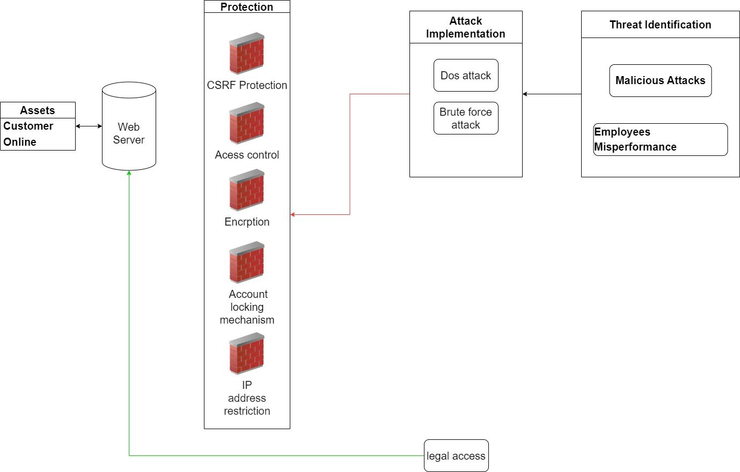
Visualisation of Security system design

Slide 8
CSRF Protection (Cross-Site Request Forgery)

Slide 9
Access Control and Encryption

Slide 10
Prevention of brute force password cracking

Slide 11
Prevention of DoS attack

Slide 12
Discussions on the important aspects of the project

Slide 13
Regulation and Ethical considerations

Slide 14
Thank you!

